Slide 1
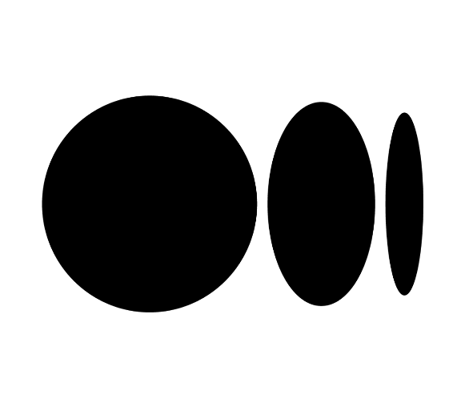
How Medium uses Graph Database for building a social graph and recommendations for personalized content experience
Presented by:
Maharsh Soni (016656770)
Bhavana Prasad Kote (016044899)
Rashmi Shree Veeraiah (016099395)
Sachin Kumar Srinivasa Murthy (016594773)
Notes:
Title Introduce teammates

Slide 2
CONTENTS
Medium
Problem statement
Data store selection
Solution
Social service architecture
Logs Aggregation/indexing
Backups
Key Learnings
Result
References

Slide 3
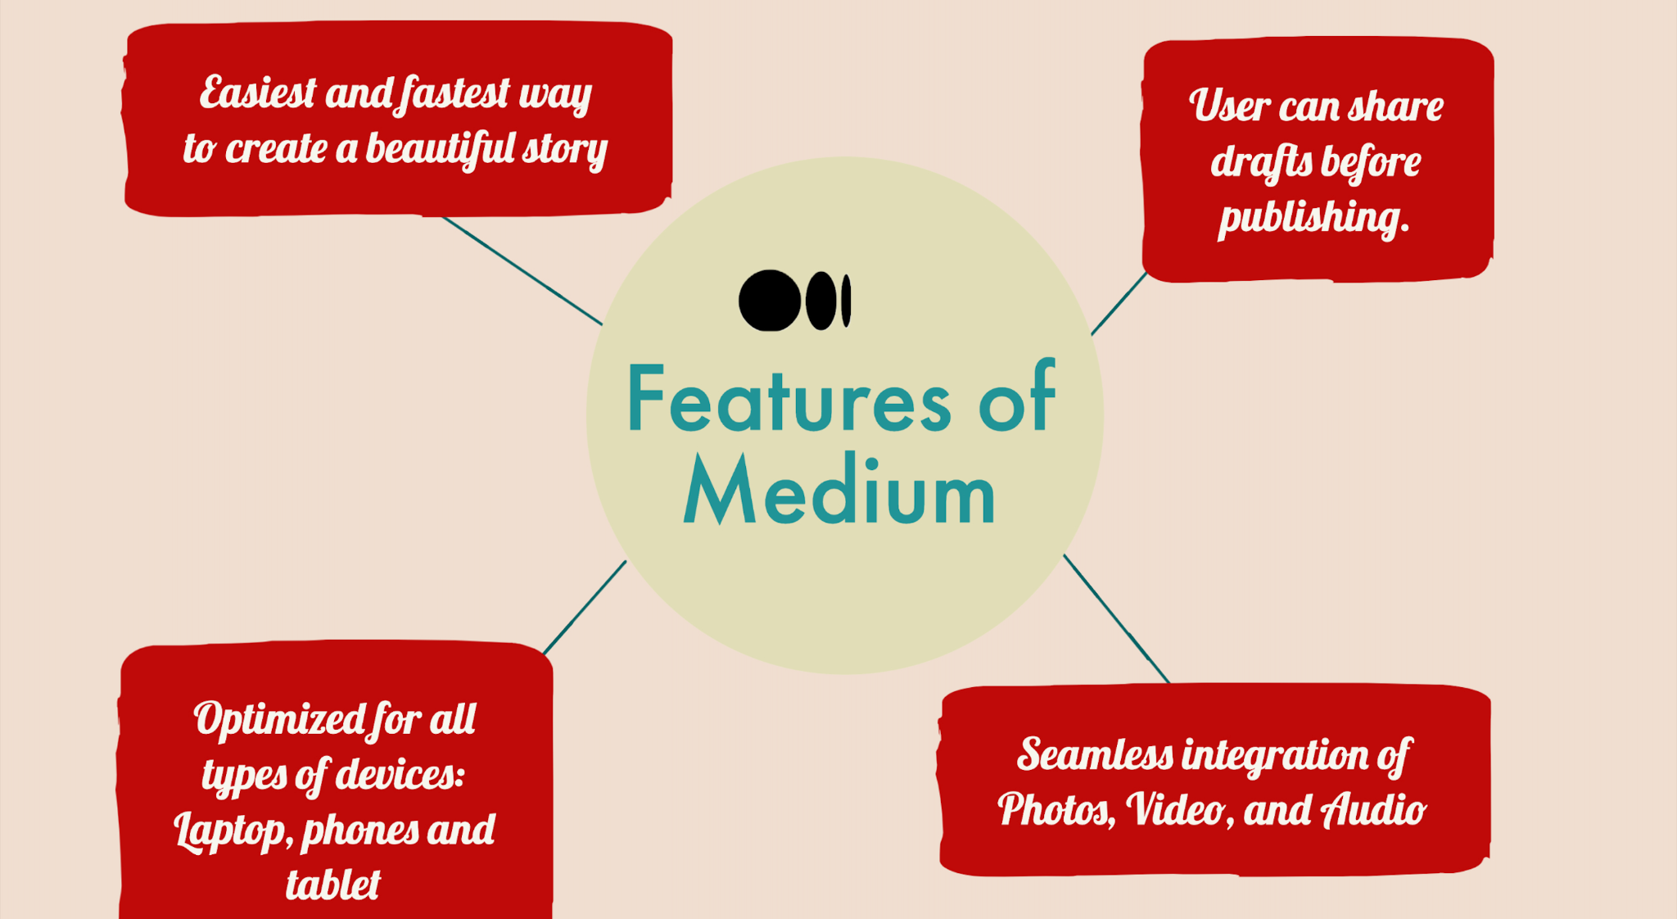
MEDIUM.COM
Follow, share, and recommend
Personalized story feed
Customized daily emails & notifications.
Notes:
Let’s talk about Medium first.
Medium is a blogging site of about 10 years old.
User can write lengthy content on Medium and it’s great for writers and readers. We have used medium in our DB project.
It’s easy, and fast
And Users can share drafts before publishing
It Can be used on any devices (laptop/ phone/ ipad)
And it Supports multimedia contents

Slide 4
PROBLEM STATEMENT
Improvise personalized content experience for users on medium
Notes:
Medium wanted to improve it’s recommendation system for the users.
In this case study, We examined merits and demerits of each of the alternative databases like AWS DynamoDB, MySQL, and Flock DB that were taken as consideration.
And how implementing solution made it easier for readers to discover relatable contents on their homepage
and how users are more likely stay on medium.com when they start exploring more articles.

Slide 5
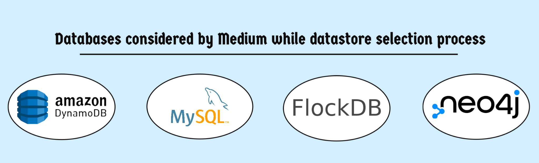
DATA STORE SELECTION PROCESS
Medium had gone through a thorough data selection process to implement a social layer on top of the platform.
In Order to implement a recommendation system to provide users a personalized content, below are the comparisons of different databases along with pros and cons evaluated with the set of requirements for problem statement made by Medium.
Notes:
Medium had studied multiple databases as They wanted to implement a social layer on top of their platform which would improve the recommendation system.
So these 4 databases were studied by medium.
Amazon Dynamo
MySQL
FlockDB
Neo4j

Slide 6
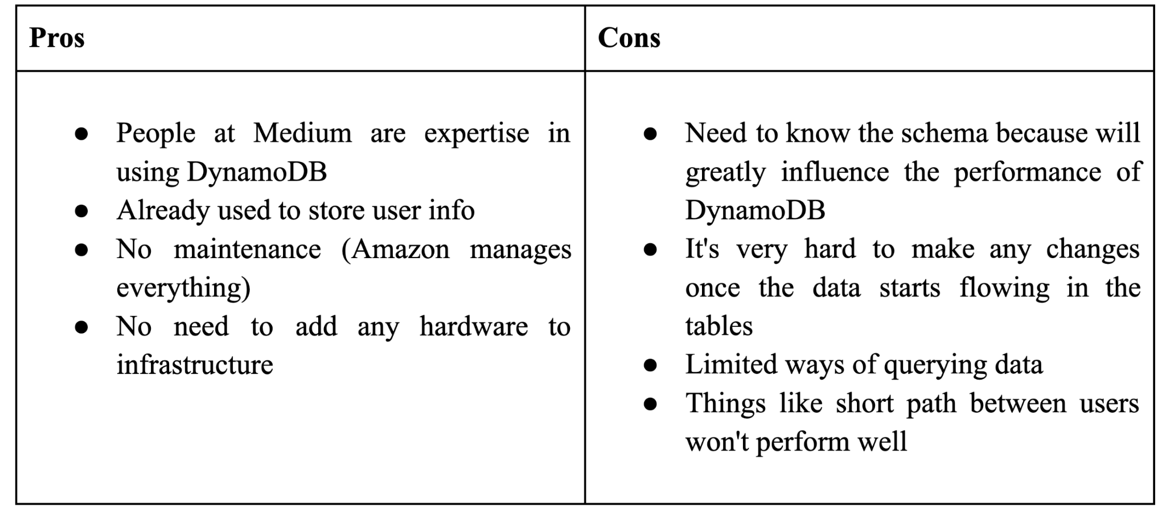
DynamoDB
A fully managed NoSQL database service provided by Amazon that stores data in Key-Value pairs. Medium uses DynamoDB to store all the user information.
Notes:
It’s a NoSQL database by amazon
Medium has already been using DynamoDB to store user’s basic information like name, email, number etc
key-value database is a type of nonrelational database that uses a simple key-value method to store data.

Slide 7
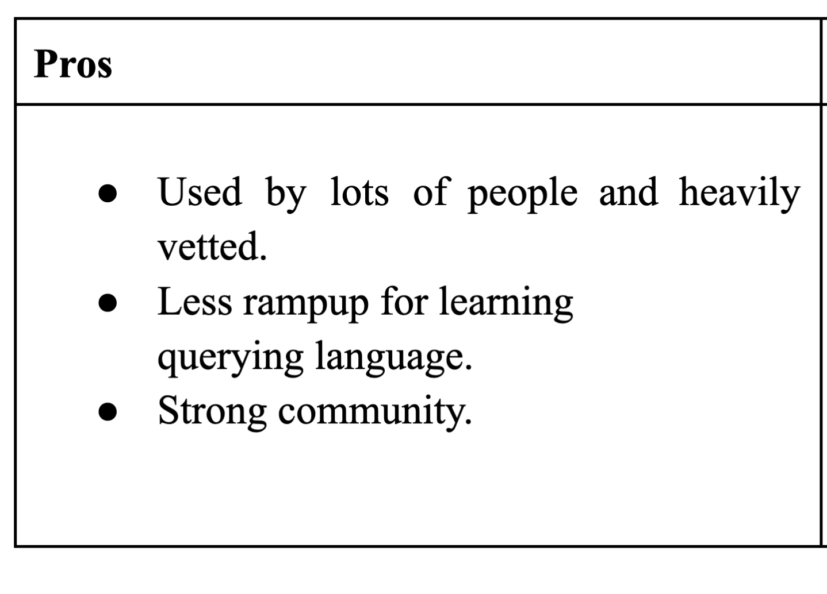
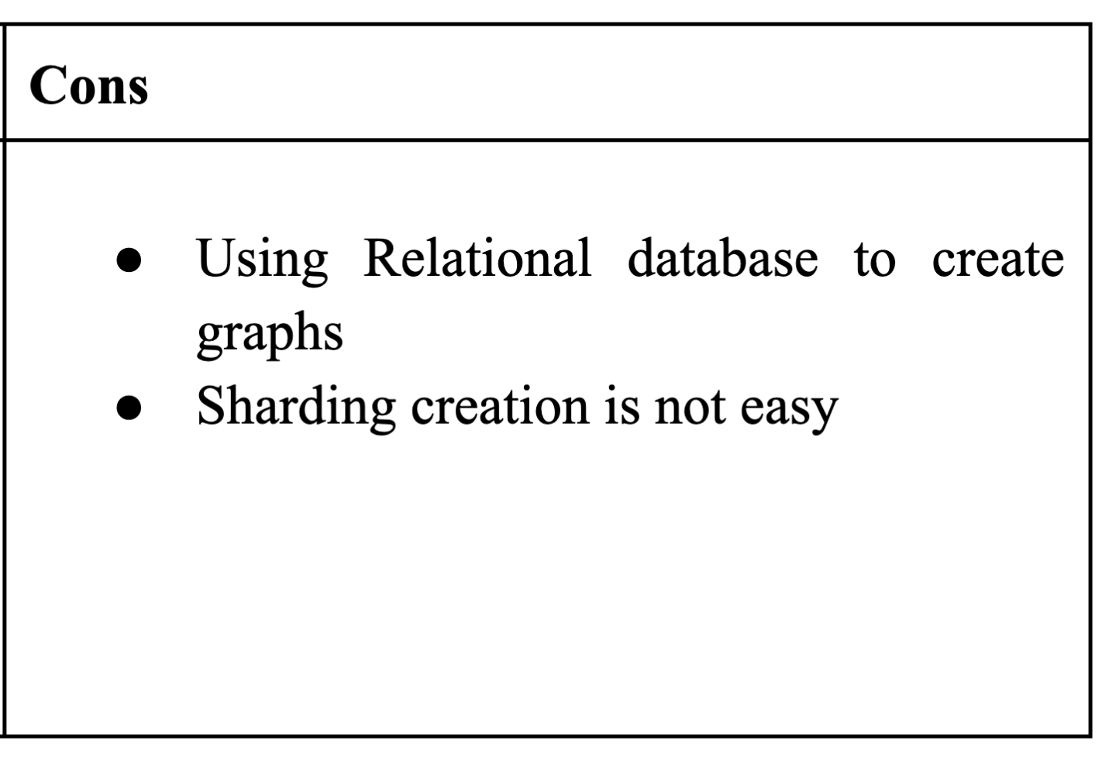
MySQL
The idea of implementing a graph database on top of a relational database did not work for Medium because graph databases and relational databases have major differences like-
Storage format
Dataset Size
Index
Transactions
Processing Power
Notes:
Storage format: Nodes represent entities and edges represent relationships in a graph database. Relational databases store data in tables with rows and columns and use "JOIN" to query quickly.
Dataset Size: Even for large datasets, graph databases are faster than relational databases.
Index: A graph database usually uses index-free adjacency, in which every node is connected to every other node, while relational databases use indexed pointers.
Transactions: Transactions in graph databases are typically not well supported, whereas accounting and transactions can be easily handled in relational databases.
Processing Power: Graph database needs more storage and processing power.

Slide 8
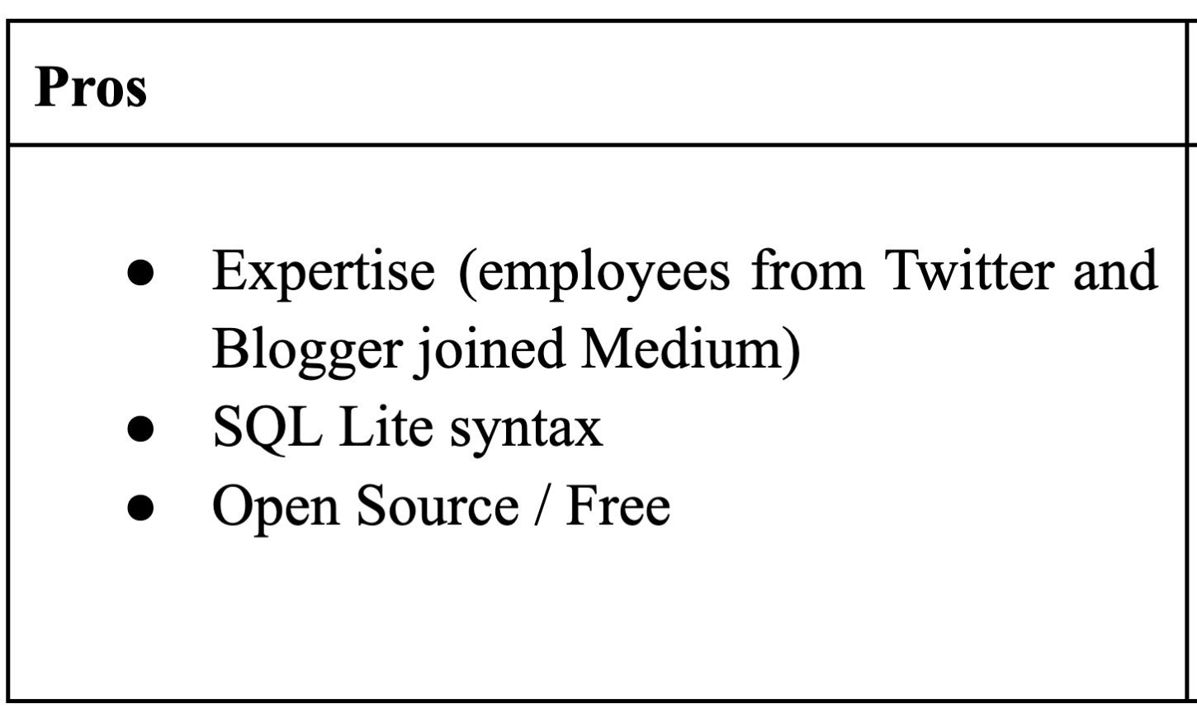
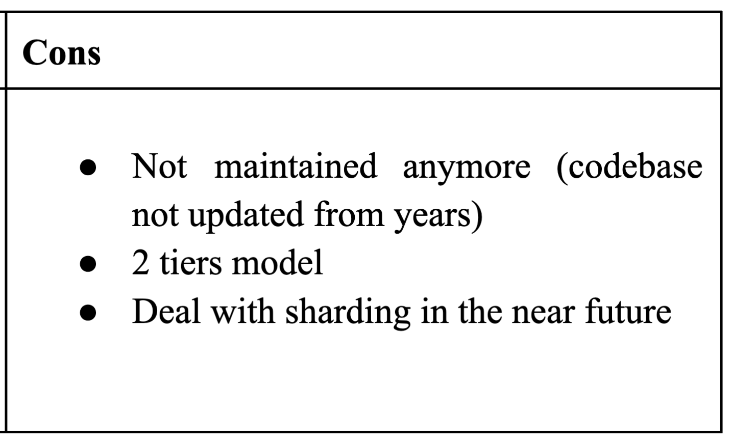
FlockDB
Used by Twitter and Blogger
Notes:
It was Used by Twitter and Blogger initially, but organizations don’t prefer this Database because it’s unstable
but still twitter uses FlockDB for some packages
Two tier model means the client is on the first tier. And database server and web application server reside on the second tier.

Slide 9
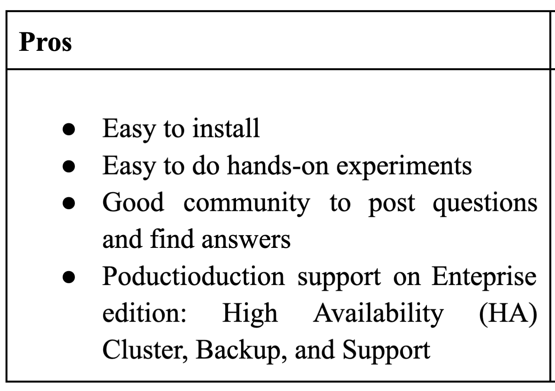
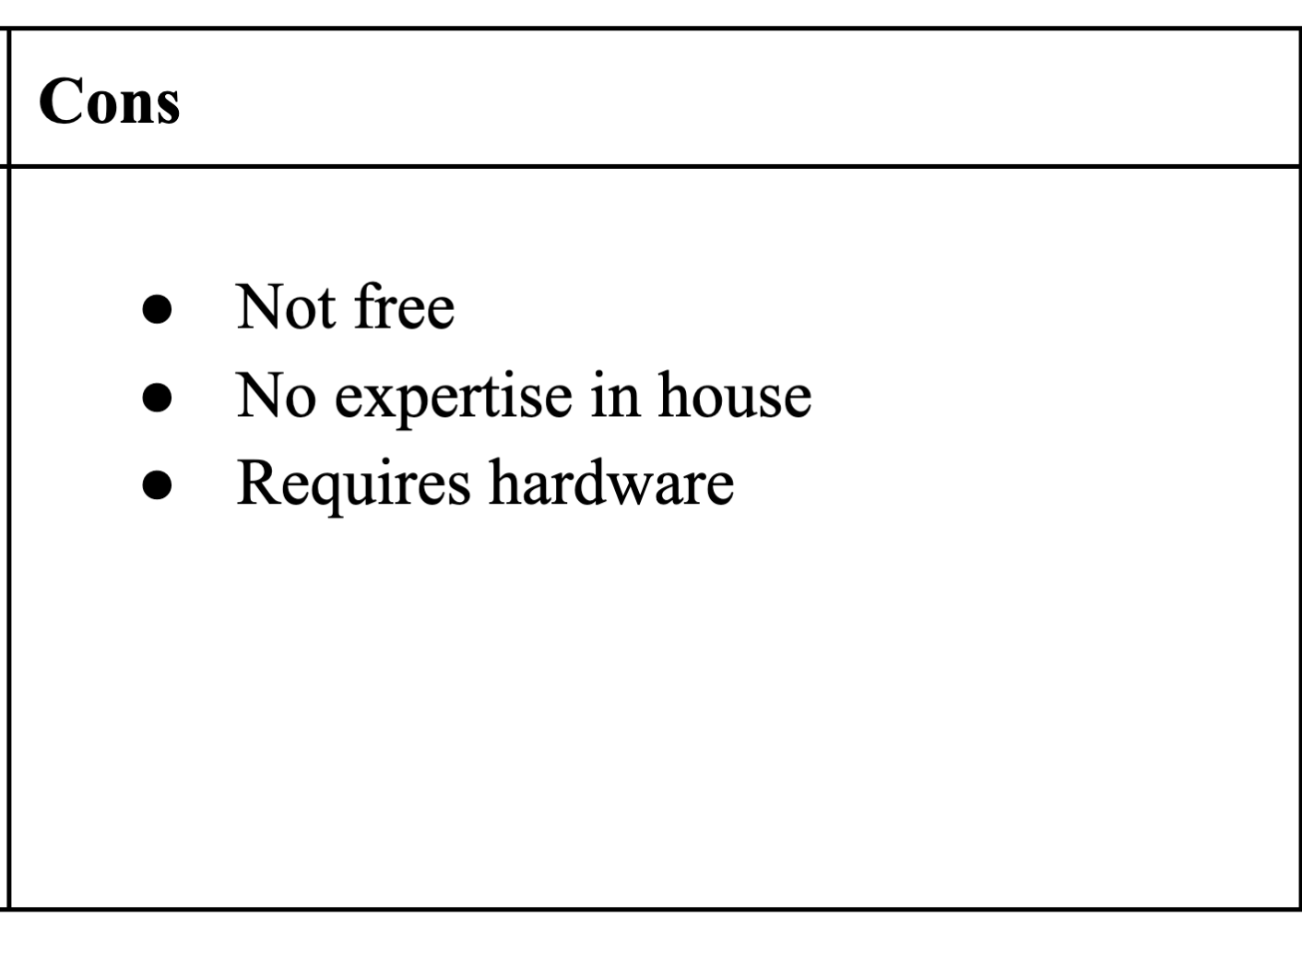
Neo4j
Completely new to Medium
Notes:
Neo4j was completely new to medium so they had lots to explore.
They shortlisted few pros and cons
Now my teammate Bhavana will take this ahead…

Slide 10
SOLUTION
Neo4j Graph Database
Medium’s goal was to build a recommendation system that provides suggestions to users on stories, users etc for personalized content experience.
Medium chose Neo4j for the graph database to store social data that aids in building a recommendation system using graphs.
Graph database makes it simpler for queries and traversal compared to complex joins.

Slide 11
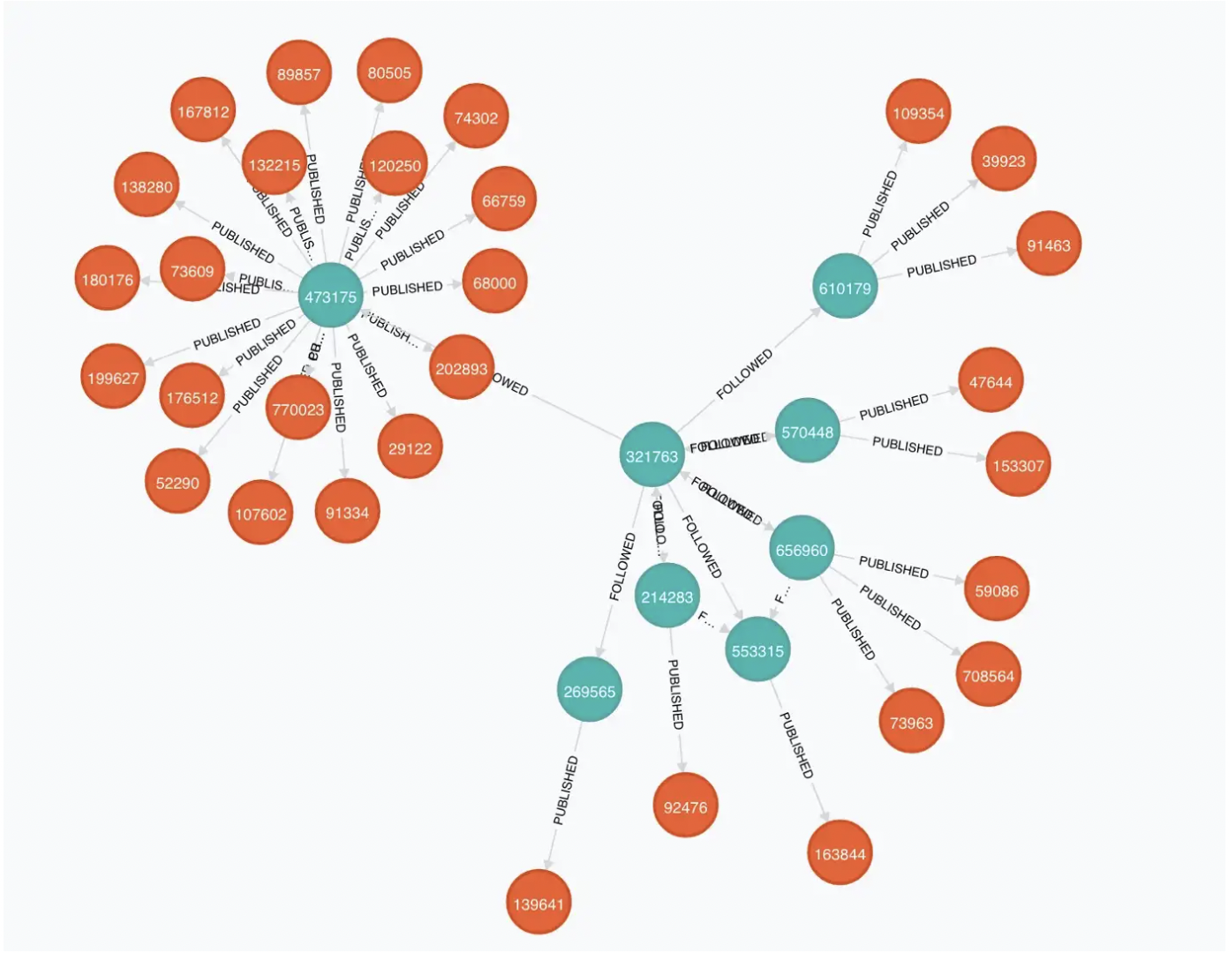
USER
POST
COLLECTION
Published
Followed
Recommended
Edited

Slide 12
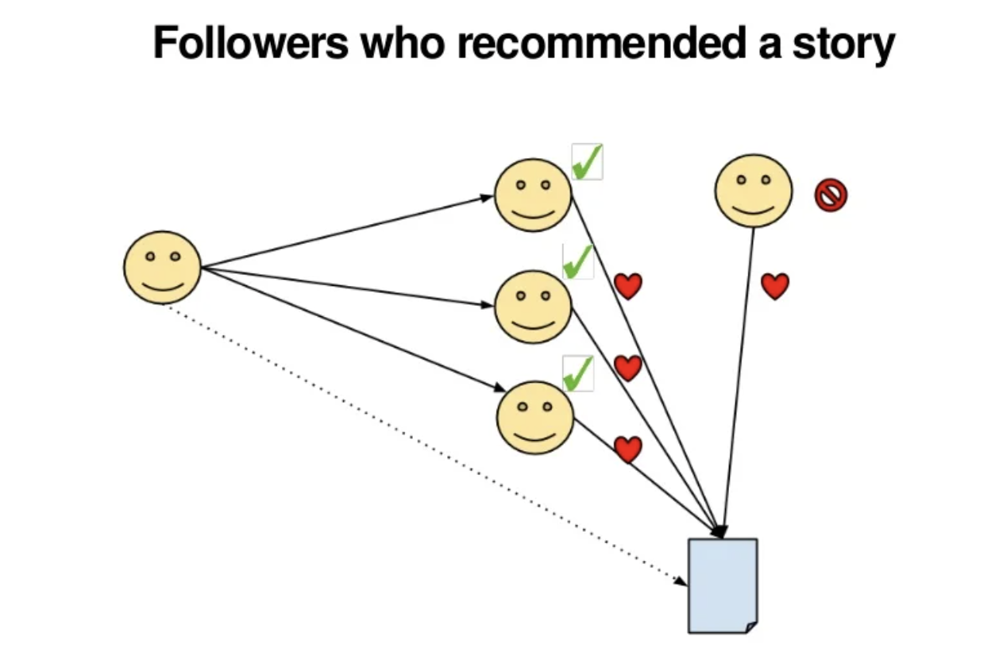
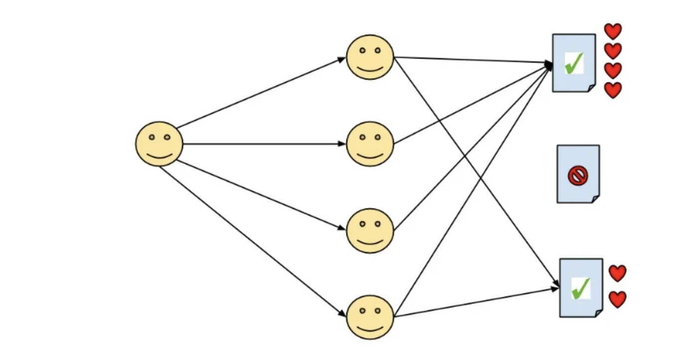
Followers who recommended a story
Top recommended story

Slide 13
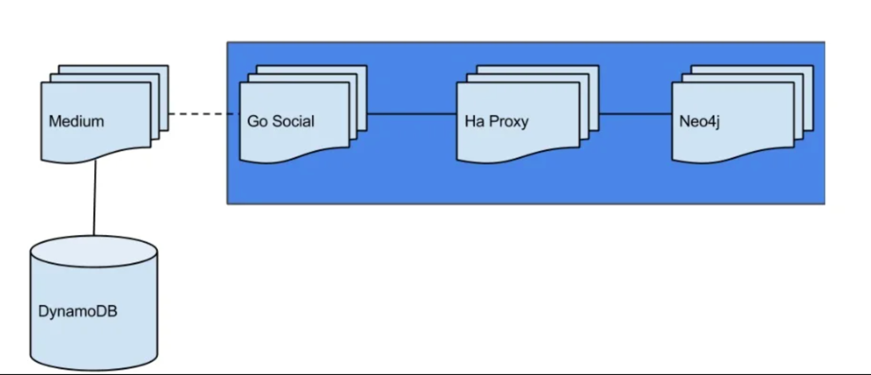
ARCHITECTURE DIAGRAM OF SOCIAL SERVICE
Medium’s Service Architecture is responsible for everything that happens on the platform, from actions to features.
GoSocial service uses two sources DynamoDB and Neo4j to fetch the user details and relationships between the nodes for Medium to provide recommendations for personalized content.
For GoSocial to talk to Neo4j, HaProxy is used. It looks at the requests sent by GoSocial and redirects the read requests to slave and write requests to master on Neo4j.

Slide 14
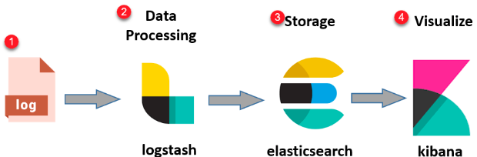
LOGS AGGREGATION /INDEXING
Logstash ingests, processes, and transfers the data to one centralized location.
The ingested data is indexed, analyzed, and searched using ElasticSearch.
Finally the analysis findings are visualized by Kibana.

Slide 15
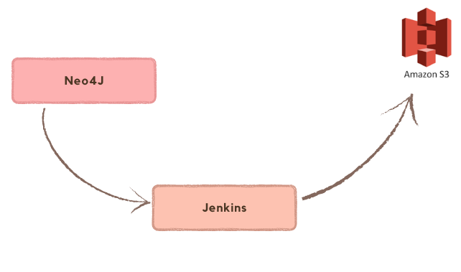
BACKUPS
Neo4j provides backup and restoration of both online and offline databases through Neo4j command line.
Medium takes advantage of the neo4j-provided backup script. They utilize a Jenkins job to trigger it.
The backup is then stored in Amazon S3.

Slide 16
KEY LEARNINGS
Determining the database based on our use case is one of the most crucial decisions because switching to another database at a later phase is an expensive and risky task.
Other than analytics and recommendation system, how Neo4j is also used for performance monitoring.
New feature we learnt - Neo4j provides backup and restore support for online and offline databases.
Importance of backing up databases and types of backups.

Slide 17
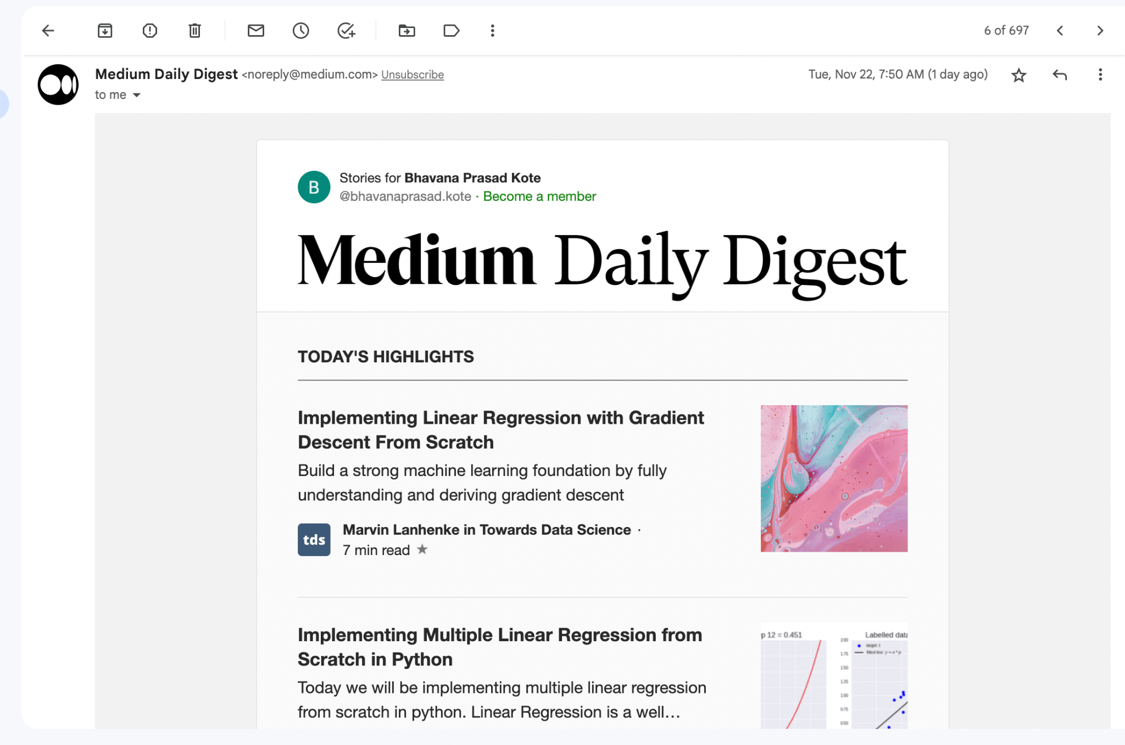
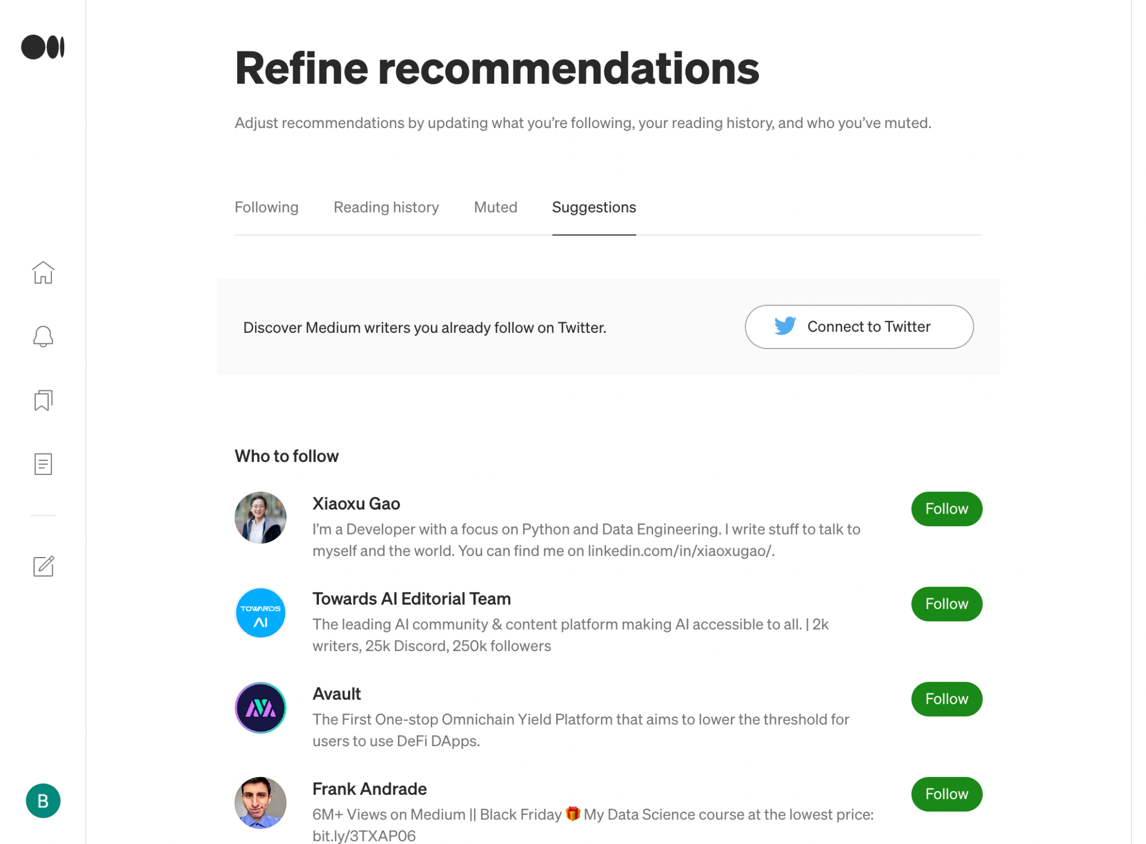
Results

Slide 18
REFERENCES
https://neo4j.com/users/medium/
https://neo4j.com/blog/medium-uses-neo4j-2014/
https://www.youtube.com/watch?v=8hOI8DJ5i_k&t=1666s
https://medium.engineering/mediums-dynamodb-data-source-for-apache-spark-62c6599a6dfd
https://medium.engineering/how-medium-goes-social-b7dbefa6d413
https://www.nebula-graph.io/posts/graph-database-vs-relational-database
https://blog.medium.com/a-better-medium-com-d468104ebb90

Slide 19
Q & A
Thank You

